Slide 1

VIGNAN INSTITUTE OF TECHNOLOGY AND SCIENCE
Ensuring High Availability in Web Applications Using Azure VM Scale Sets
BY,
KOTHIREDDY GANGOTHRI
BHUPATHI DEEPTI BHAVYA SUMALYA
GURRAM VYSHNAVI REDDY
KATTEKOLA SREELEKHA
PONUGOTI ASHRITHA

Slide 2
Introduction
High availability is a critical requirement for modern web applications, ensuring they remain accessible and reliable even under varying workloads or unexpected failures. Azure Virtual Machine Scale Sets (VMSS) offer a powerful and scalable solution to achieve this. By automatically distributing traffic across multiple instances, scaling resources dynamically based on demand, and providing fault tolerance, Azure VMSS ensures that web applications are resilient and performant. This article explores how Azure VM Scale Sets can be leveraged to enhance the availability, scalability, and reliability of web applications, while simplifying management and reducing operational overhead.

Slide 3
IMPLEMENTATION
1. website creation.
2. githb upload (https://github.com/Ashritha-gif/oxer.git)
3. create VM with custom script
4. after deployment - check vm if our website is working or not
5. Capture > image > delete vm check box on> "imagegallery" > "imagedef" > version 1.0.0 > create
6. create vmss from the output
7. check if the image is our image or something else.
8. Set autoscaling (1,2,1) 25% increase 10% decrease , create loadbalancer in networking tab
9. create VMSS
10. after creation > go to instances > select the vm > copy and paste your ip address in new tab to check your website is live
11. go back in the vm > set inbound rule (*) in network settings > connect to vm in powershell > run stress test ( stress --cpu 1 --vm 1 --io 1 --hdd 1 --timeout 5m )
12. come back to portal in vmss > metrics > percentage cpu graph, set time to last 30min and 1 min update > look if the stress is working and check/refresh the instances in other tab > once the cpu stress is beyond our given rule, the instance would increase to 1.
13. show that we can access the website via 2 instances ip address and is highly available.

Slide 4
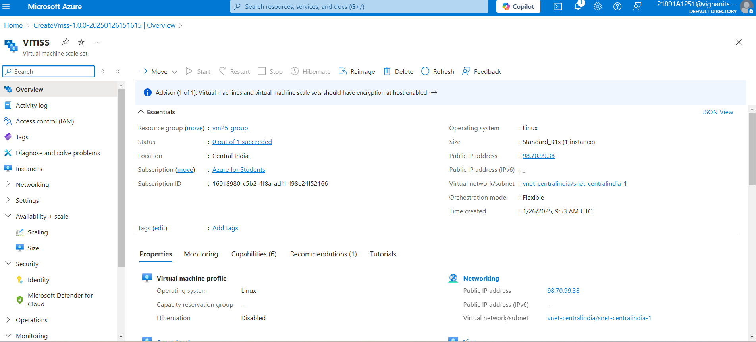
VMSS

Slide 5
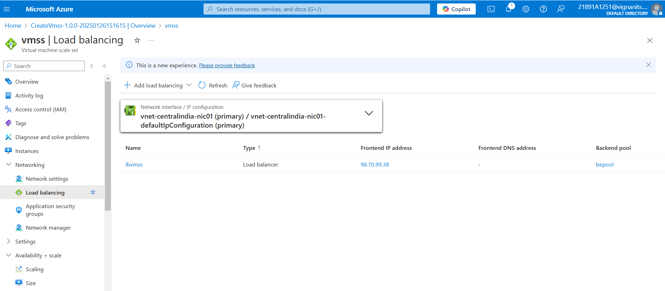
VMSS LOAD BALANCING

Slide 6
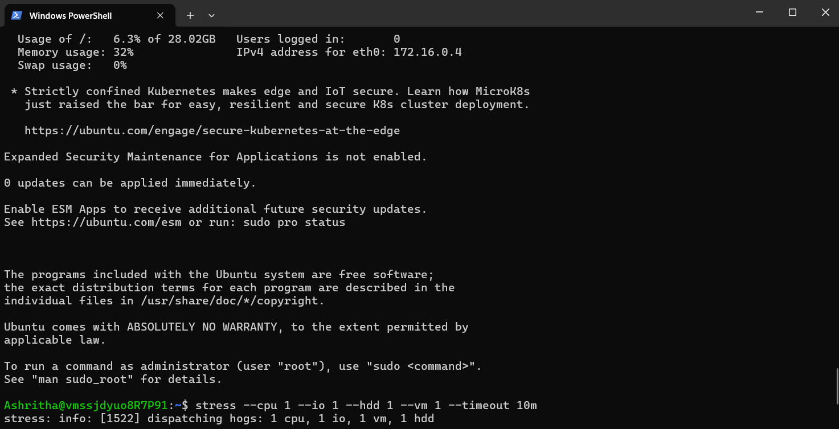
VMSS POWERSHELL

Slide 7
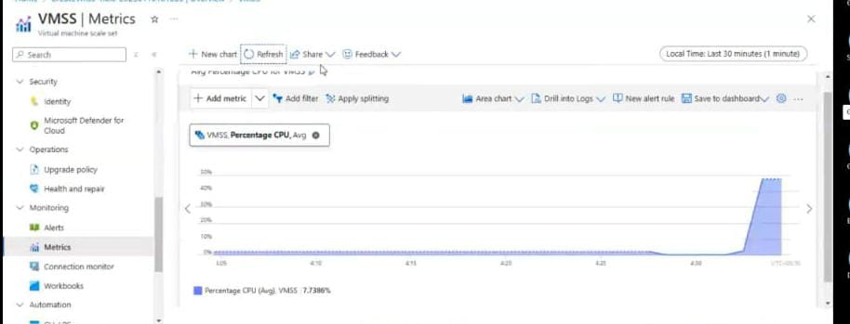
VMSS METRICS

Slide 8
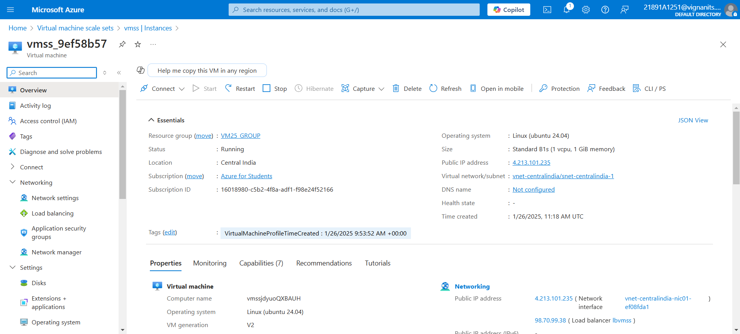
VMSS IP

Slide 9
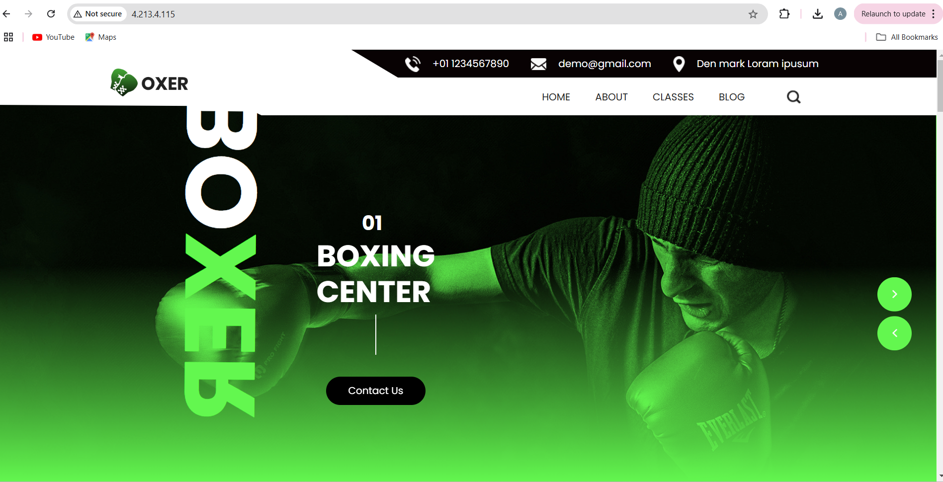
WEBSITE

Slide 10
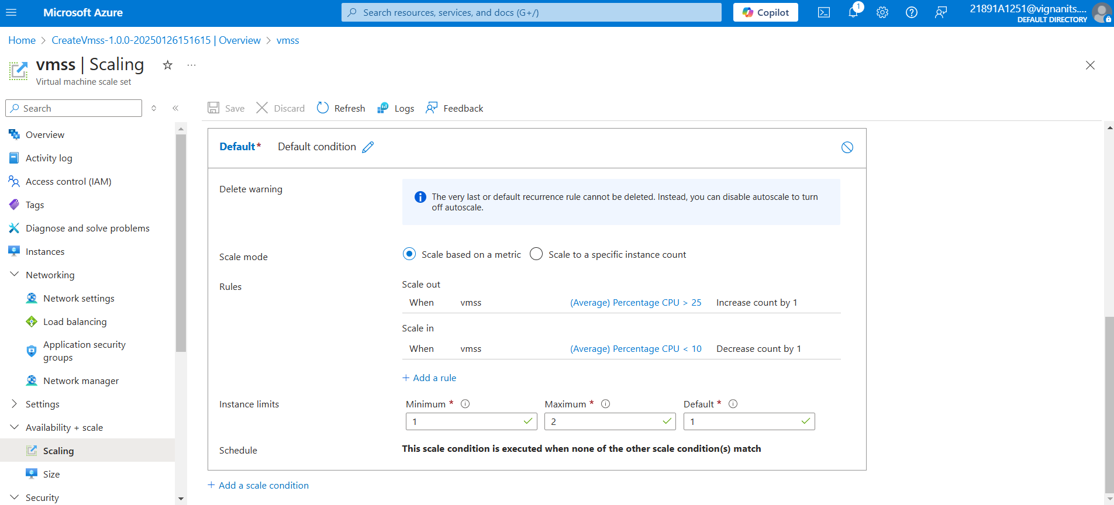
VMSS SCALING

Slide 11
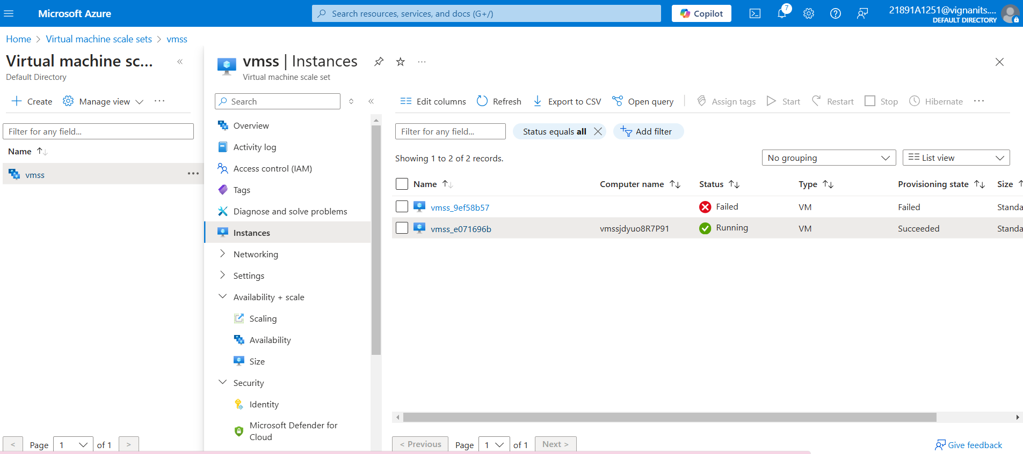
VMSS INSTANCE
We can see that a new instance is created, however, as we are using the azure student account there are some limitations so, the VM is created but there is no public ig assigned. We can see that VMSS is perfectly working.

Slide 12
THANK YOU

